Slide 1

Knowing the movement
How we know through the way we are made to know?

Slide 2
What is Renaissance?
‘Modernity’?
How?
Rebirth
Recovery
Rescue
to
Revive
Recreate
Where?
By whom?

Slide 3
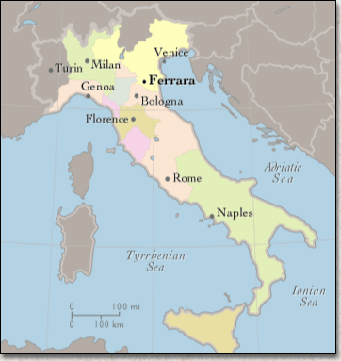

Slide 4
Developments
Science
Humanism

Slide 5
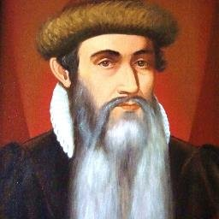
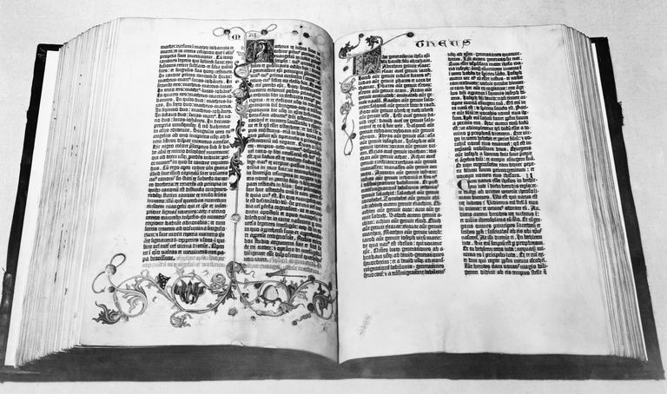
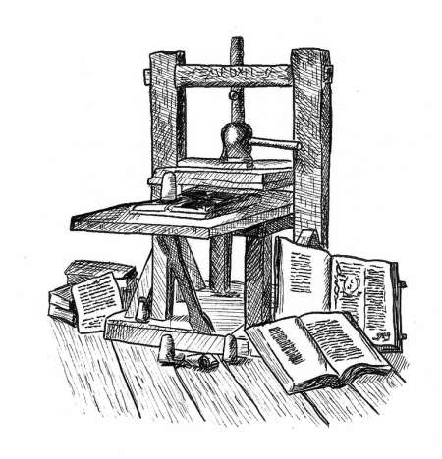

Slide 6

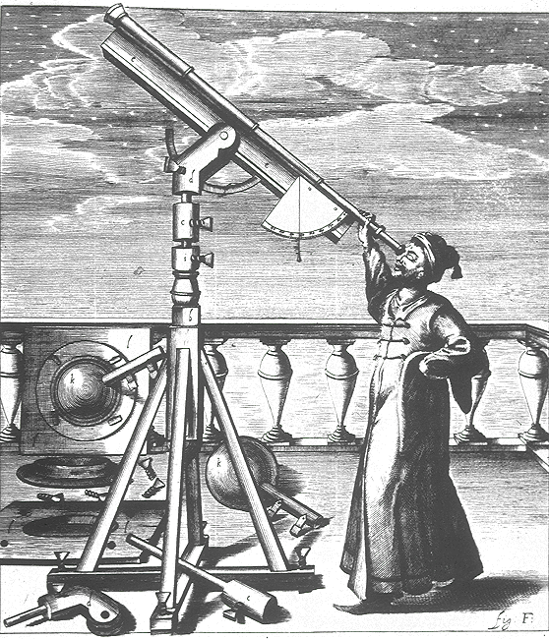
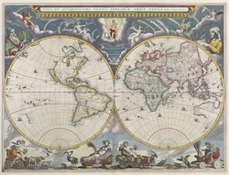

Slide 7
Humanism
“Men are made, not born,” Erasmus
To be truly human, one would need to become truly educated
Humanists stressed the dignity of man, the best of God's creatures below the angels
In a profound way, the humanists and the Renaissance invented history

